Slide 1
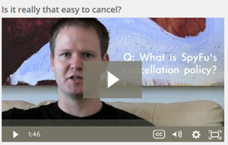
Your 30 Day Money Back Guarantee
This is a bold promise, and we stick by it, because we are confident we can make this work for you.
If for any reason, your Virtual Employee is unable to fulfill his or her duties with you to a reasonable standard, just let us know in the first 30 days and you will get a Full Refund, or we will change your Virtual Employee for someone more suitable.

